Slide 1

Unit-12: Introduction to Prolog
Artificial Intelligence (AI)
3170716
Prof. Jayesh D. Vagadiya
Computer Engineering Department
Jayesh.vagadiya@darshan.ac.in
9537133260

Slide 2

Outline
Introduction
Facts
Objects
Relations
Predicates
Structure of Prolog Program
Installing GNU Prolog Complier
Examples
Recursion in Prolog
Cut and fail
List
List Examples
Looping

Slide 3
Introduction
Prolog stands for Programing in logic.
Prolog is a declarative programming language unlike most common programming languages.
In a declarative language the programmer specifies a goal to be achieved and then the Prolog system works out how to achieve it.
Rather than describing how to compute a solution, a program consists of a data base of facts and logical relationships (rules).
The user asks a question to obtain a solution of a problem.
When asked a question, the run time system searches through the data base of facts and rules to determine (by logical deduction) the answer.
Prolog is a declarative language, which means that a program consists of data based on the facts and rules, i.e., relationships among these facts.
Prolog is used some areas like natural language processing, artificial intelligence, expert systems, automated reasoning, etc.

Slide 4
Facts, Objects, Relations
Samyra likes John.
Likes(samyra, john).
Fact
Relation
Objects

Slide 5
Facts, Objects, Relations
Facts can be describes as a symbolic Relationships
Facts are statements about what is true about a problem, instead of instructions how to accomplish the solution.
The Prolog system uses the facts to work out how to accomplish the solution by searching through the space of possible solutions.
Example:-
Bob is a student.
student(bob).
This expression is called a clause.
An object is the name of element of certain type.
A Relation is a name that defines the way in which a collection of objects or variables belong together.

Slide 6
Predicate
A relation identifier is referred to as a predicate
Example:-
Car is blue
Is(car, blue)
Predicate express a relationship.
The element within the parenthesis are the arguments of the predicate, which may be objects or variable.
The word before the parenthesis is the name of relation.

Slide 7
Rules
Rules are used when you want to say that a fact depends on a group of facts.
Rule consist of a head and a body connected by the symbol :- (IF)
Syntax of rule
<head> :- <body>
Read ‘:-’ as ‘if’.
likes(john,X) :- likes(X,cricket).
“John likes X if X likes cricket”.
Rules always end with ‘.’

Slide 8
Structure of Prolog Program
Domains
// defining Objects, variable
//Person1,Person2 = Symbol
Predicates
// defining a Relation and Function
//likes(Person1,Person2)
clauses
// defining Facts,Rules
// likes(aditya, naina).
//likes(bob, hezal).

Slide 9
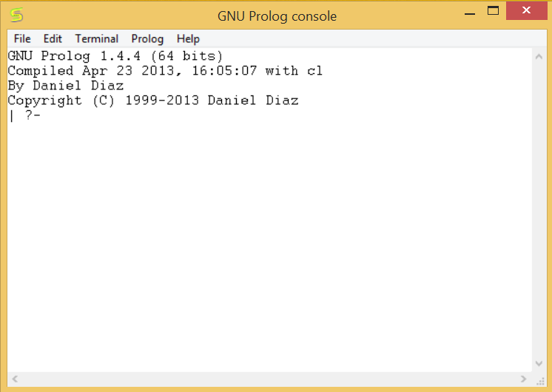
Installing GNU prolog Complier
This is a prolog interpreter working under the GNU licence. Nice things about it are: Windows/UNIX support, comprehensive, free.
Download GUN prolog form http://www.gprolog.org/
Double click setup file to install
After installation complete, run GUN Prolog

Slide 10
How to load and run ?
Load
| ?- [prolog file Name].
Run
| ?- Predicate(arguments).

Slide 11
Example
Example1.pl
Example2.pl
Domains
Person1,Person2 = Symbol
Predicates
likes(Person1,Person2)
Clauses
likes(aditya, naina).
likes(bob, hezal).
boy(abc).
boy(bob).
boy(johan).
girl(hezal).
girl(xyz).
Output
Output
Goal:boy(bob).
True
Goal:girl(bob).
False
Goal:likes(bob, hezal).
True
Goal:likes(bob, mery).
False

Slide 12
Find Maximum number from two numbers
Max.pl
Max.pl
max(X,Y,X):- X>=Y.
max(X,Y,Y):- Y>X.
max(X,Y,Z) :- ( X =< Y -> Z = Y; Z = X ).
Output
Goal:max(3,4,MAX).
MAX = 4
Goal:max(5,4,MAX).
MAX = 5

Slide 13
Recursion in prolog
Any function which calls itself is called recursive function.
In Prolog, recursion appears when a predicate contain a goal that refers to itself.
This simply means a program calls itself typically until some final point is reached.
In Prolog and in any language, a recursive definition always has at least two parts.
A first fact that act like a stopping condition and a rule that call itself simplified.
At each level the first fact is checked. If the fact is true then the recursion ends. If not the recursion continue.
A recursive rule must never call itself with the same arguments. If that happens then the program will never end.

Slide 14
Find factorial of given number
fact.pl
fact(0,Result) :-
Result is 1.
fact(N,Result) :-
N > 0,
N1 is N-1,
fact(N1,Result1),
Result is Result1*N.
Output
Goal:fact(2,F).
F = 2
Goal:fact(3,F).
F = 6

Slide 15
Find the sum of first N natural numbers
Number.pl
sum(0,0).
sum(N,R):-
N > 0,
N1 is N-1,
sum(N1,R1),
R is R1+N.
Output
Goal:sum(4,SUM).
SUM = 10

Slide 16
Print Fibonacci series
Fibonacci.pl
fibonacci(1).
fibonacci(N) :-
N1 = N - 1,
N1 >= 0,!,
fibonacci(N1),
write(F1," ,"),
F = F1 + N.
Output
Goal:fibonacci(2).
0 1
Goal:fibonacci(3).
0 1 2

Slide 17
Fail
Fail predicate simply fails the rule.
A typical use of fail is a negation of a predicate
when Prolog fails, it tries to backtrack. Thus fail can be viewed as an instruction to force backtracking.
Fail.pl
a(X) :- b(X),c(X),fail.
a(X) :- d(X).
b(1).
b(4).
c(1).
c(3).
d(4).
Output
Goal:a(x).
X = 4

Slide 18
Cut
Sometimes it is desirable to selectively turn off backtracking.
Cut always succeeds, but cannot be backtracked.
The cut effectively tells Prolog to freeze all the decisions made so far in this predicate. That is, if required to backtrack, it will automatically fail without trying other alternatives.
Performance is the main reason to use the cut.
The Symbol of cut predicate is “!”
cut.pl
Output
a(X) :- b(X),!,c(X).
a(X) :- d(X).
b(1).
b(4).
c(1).
c(3).
d(4).
Goal:a(x).
X = 1

Slide 19
Cut and Fail With Example
A
Initial
Information for Goal state
I will definitely see a River – Cut Condition
I will never see a shop – Fail Condition
B
Cut condition
C
River
F
D
E
G
N
H
K
Shop
Fail condition
I
J
L
M
Goal
o
P

Slide 20
List
it is a finite sequence of elements.
A list in PROLOG is a structure of the form
[t1,t2,t3 … tn]
The elements in list organised in two section head and tail.
The direct access to only one element call head , while the rest forms the list called the Tail.
[Head|Tail]
where Head is a single element, while Tail is list.

Slide 21
Example of List
To check weather an object X is member of list L or not.
Calculating the number of items of a given list.
Output
List.pl
Goal:find(a,[a,b,c]).
true
Goal:find(d,[a,b,c]).
false
find(X,[X|TAIL]).
find(X,[_|TAIL]):- find(X,TAIL).
Output
List.pl
Goal:length([a,b,c],N).
N = 3
Goal:length([],0).
N = 0
length([],0).
length([_|TAIL],N) :-
length(TAIL,N1),N is N1 +1.

Slide 22
Example of List
Find the nth element of a given list.
Merge two List
Output
List.pl
Goal:match([a,b,c],0,N).
N = a
match([H|_],0,H).
match([_|T],N,H) :-
N > 0,
N1 is N-1,
match(T,N1,H).
Output
List.pl
Goal:con([a,b,c],[1,2],N).
N = [a,b,c,1,2]
con([],L1,L1).
con([X|Tail],L2,[X|Tail1]):- con(Tail,L2,Tail1).

Slide 23
Thank You!

